Slide 1
Updates and Reminders
HW #4 due by the start of class on Thursday
Primary literature workshop #3 on Monday
Quiz #2:
Answer key available on canvas
Review your answers AND the answer key before asking for clarifications

Slide 2
Term Project #2
Propose a RATIONAL therapy to target cancers where your genes are compromised.
4 MORE primary research articles
Propose two therapeutic approaches (different drug targets)
Can not simply ‘restore’ your cancer gene’s function
Detailed instructions on canvas
10 groups of 3-4: based on cancer gene pathway, function similarity, or cancer context
Use whiteboards to find potential partners based on individual cancer genes from project #1
Use online discussion boards to find potential partners (search original discussion board with cancer gene assignments for other in your pathway)
Self assign a group on canvas by Monday/17→ email me your groups’ 3-4 cancer genes and unifying theme: must reflect your cellular pathway or function

Slide 3
Lecture 12
Chapter 10 objectives
Be able to describe two cell autonomous limitations to cellular immortalization: senescence and crisis
The two headed coin: be able to explain how crisis can both limit and promote cancer development
Be able to explain two mechanisms by which cancer cells can overcome crisis

Slide 4
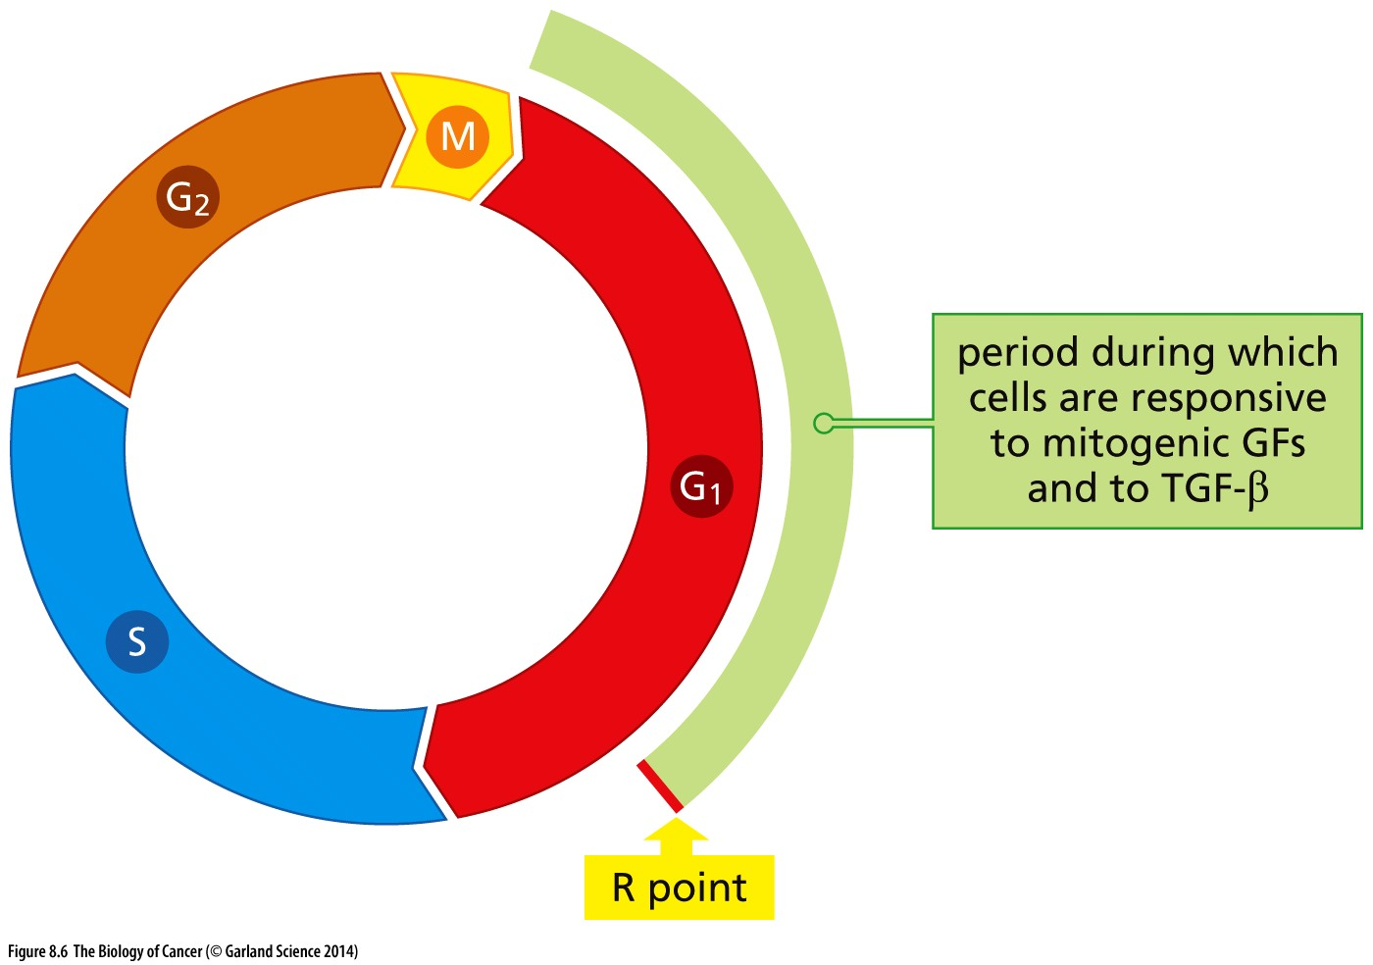
Cell cycle commitment
Would you expect that corruption of this checkpoint alone is sufficient to cause cancer?
Restriction point: “Point of no return”
Mitogenic signal present? Nutrients available? Genome intact?
Yes → proceed to S phase
No → enter G₀/quiescence

Slide 5
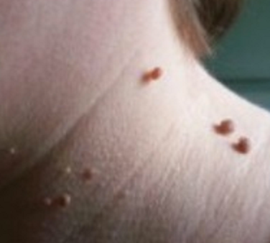
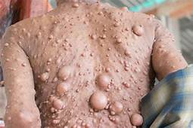
Over-proliferation and Cancer
Uncontrolled proliferation alone is necessary (& often an early step in tumor initiation) but is not sufficient to cause cancer
What does this mean?
Transient over-proliferation can cause skin tags and moles
Persistent over-proliferation can cause benign (non-malignant) tumors
Ex: neurofibromatosis: caused by mutations in the tumor suppressor gene NF1

Slide 6
Over-proliferation and Cancer
Increased proliferation (oncogene activation, loss of tumor suppressor function)
Other mutations (to become invasive, metastatic, etc)
→ Cancer!
Tumors are clonal: all cells in the tumor come from the same original cell
All mutations must be acquired in the SAME cell lineage
How are new mutations acquired?
over time with random replication-induced DNA damage
Is rate of cell proliferation the only thing limiting cancer formation?

Slide 7
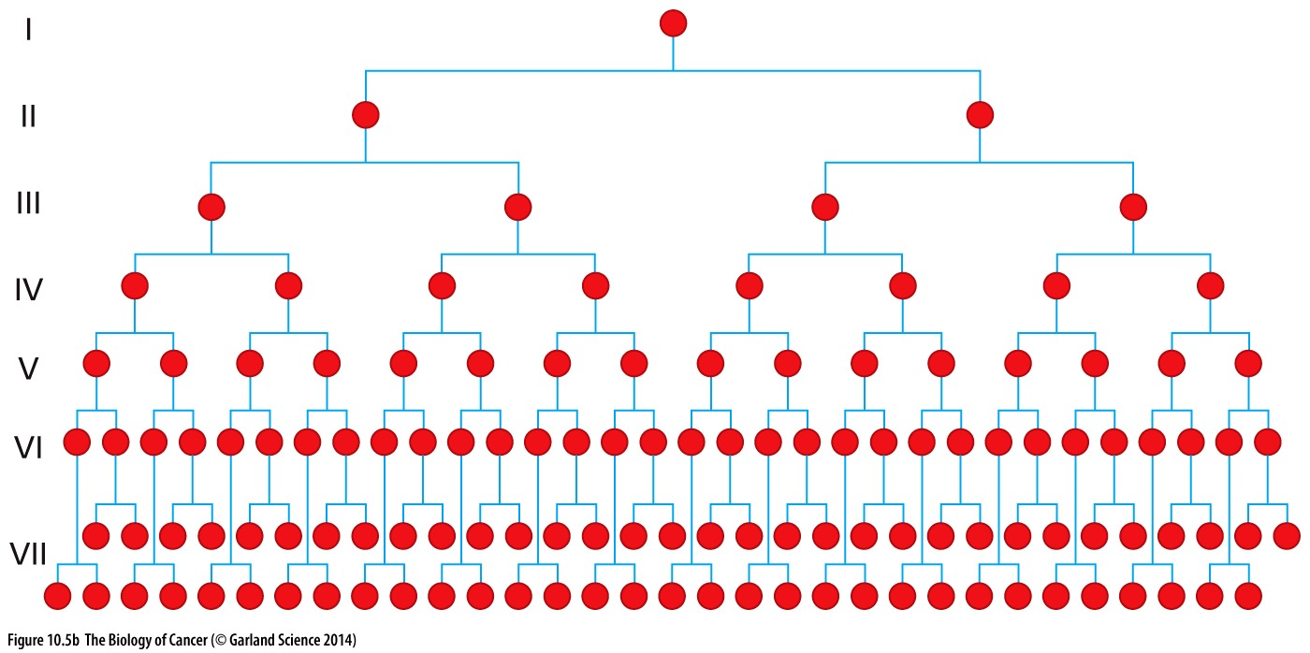
Cell growth is exponential
2 cells become 4 cells become 8 cells become 16 cells….

Slide 8
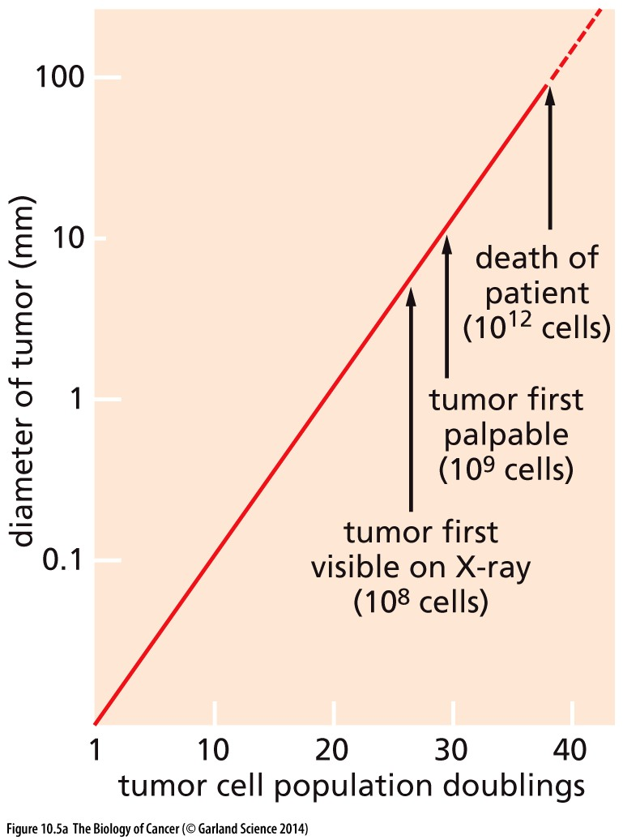
Clinically detectable tumor contains ~10⁸ cells
Would only need as few as 30 doublings to accrue this many!
Why then do tumors take DECADES to develop?
Is rate of cell proliferation is NOT the only thing limiting cancer formation!

Slide 9
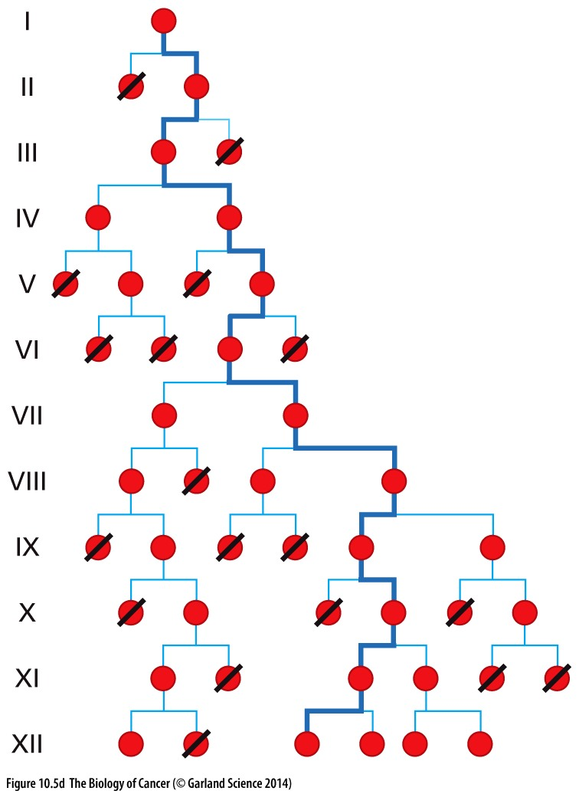
Attrition during each cell cycle limits tumor growth
REALITY
EXPECTATION
With each cell division, DNA damage or chromosome gains and losses can be lethal events
Tumors also contain lots of apoptotic cells
Not clear WHAT the rate of attrition is but evidence suggests would take >>> 30 doublings to form a tumor (only 5 cells remain after 12 doublings)
**remember tumors are clonal and must all derive from the same original cell

Slide 10
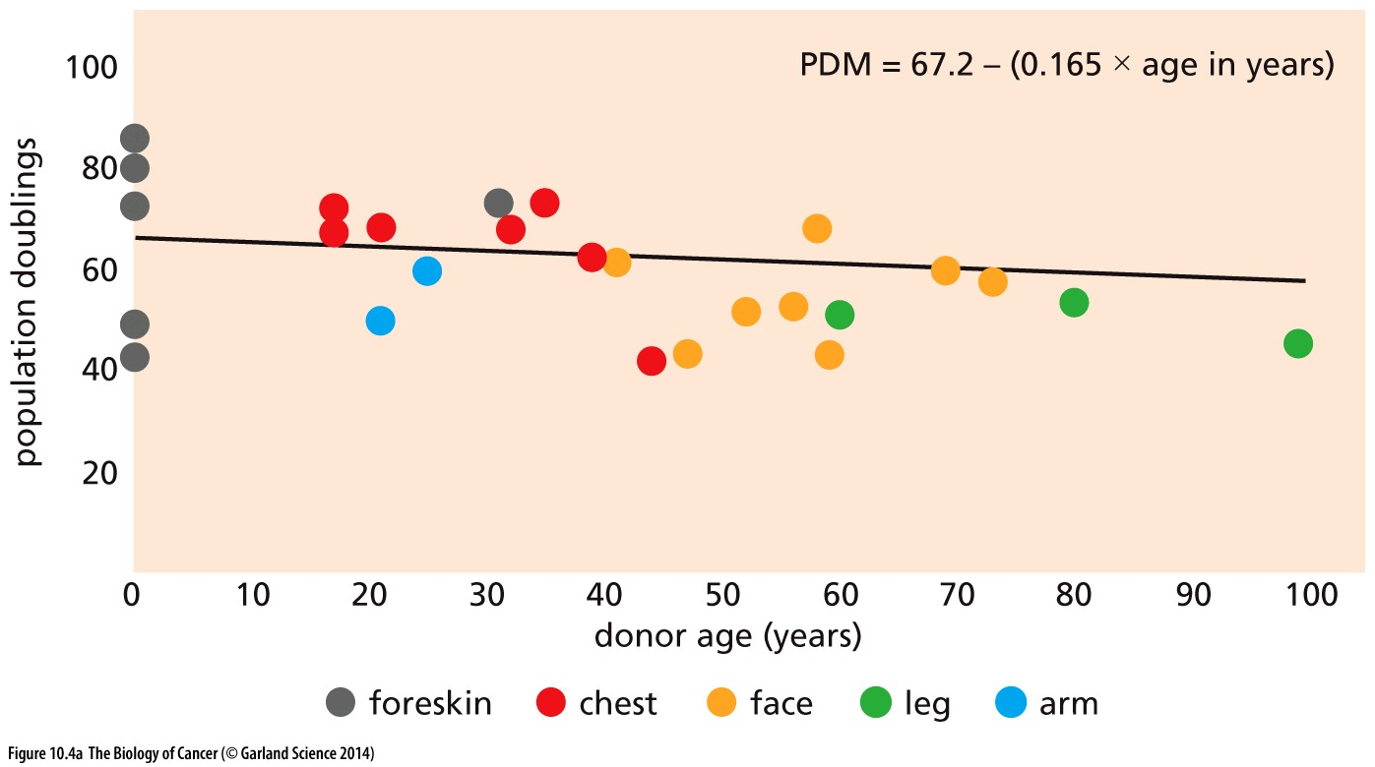
Why does it matter how many doublings it takes?
Cells have an intrinsic limit to how many times they can divide
→ experimentally determined to be as few as 50 or 60 doubling cycles
Even if oncogeneic mutations were acquired in infancy, a detectable tumor mass would never form before cells stopped dividing!
Cancer cells MUST bypass this intrinsic limit
Mutational analysis suggests tumors may need 200+ generations to form

Slide 11
Limit to immortality #1
Replicative Senescence
Are metabolically active but non-proliferative
Are sustained by growth factors & nutrients, but do not re-enter the cell cycle
Disconnect between growth factor signaling and proliferative response are poorly understood
Together with the fact that replicative potential decreases with age suggests a cell-autonomous mechanism regulates the finite # of divisions

Slide 12
Inducing senescence
Cell Physiological stresses → senescence
Signaling cascade involving CDK inhibitors p16^{INK4A} and p21^{Cip1} and p53
Function through pRB & p53 pathways and so may be bypassed in cancers where these pathways are corrupted
Still not clear what factors activate this signaling
May be a measure of accumulated stress, not cell age or # divisions per ser

Slide 13
cancer deterrent or promoter?
Senescence limits cancer cell growth
Can cells detect and respond to cellular changes induced by oncogenes?
High expression of oncogenes (like Ras) can promote senescence
Ras often become amplified later in tumor development (after senescence-inducing pathways are bypassed?)
Senescence promotes cancer growth
Release pro-inflammatory cytokines (for weeks → months)
Recruit immune cells that can in turn perturb the microenvironment and promote tumor progression (Chapter 11)

Slide 14
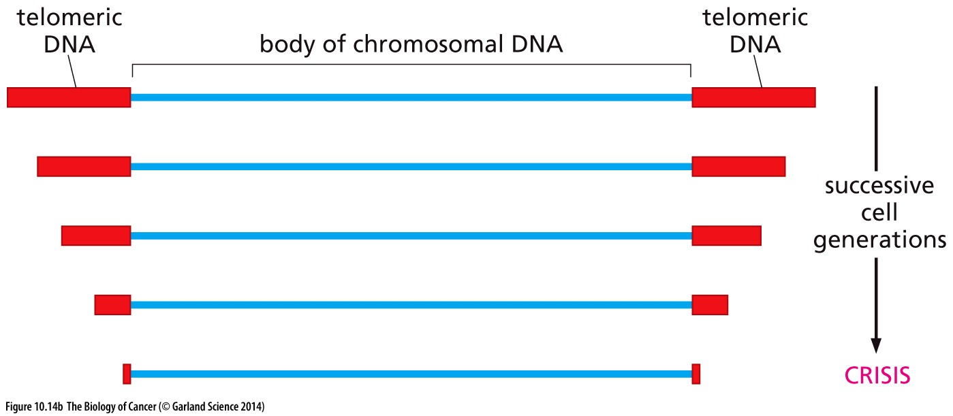
Limit to immortality #2
Even if senescence is bypassed, cells only have only another 10-20 generations before they experience widespread apoptosis
Brings us to 60-80 total generations → still not enough for a tumor to form!
What causes this apoptosis?
Progressive telomere shortening!

Slide 15
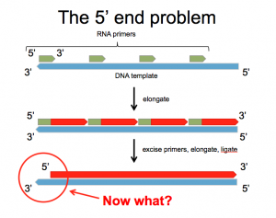
Why do telomeres shorten?
Telomeres erode with each cell cycle due to the ‘end replication problem’
DNA polymerizes 5’ to 3’ ONLY
DNA polymerase requires an RNA primer to start replicating
RNA primer is removed
No place to put new primer
End remains unreplicated
repeat next cell cycle…

Slide 16
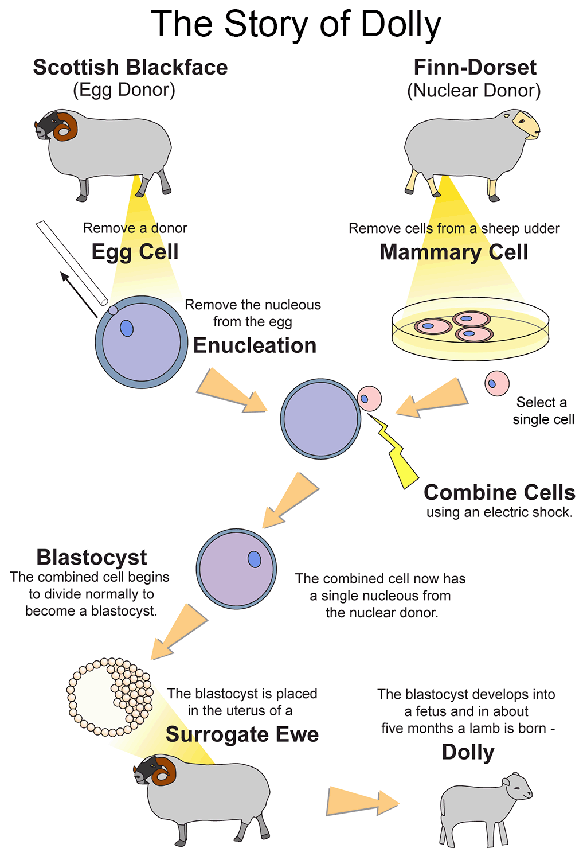
Telomeres shorten with age
1996-2003 Dolly became the first mammal to be cloned
Dolly’s DNA donor was 6 years old
At 1 year, Dolly’s telomeres were only 80% as long as they should be
Died prematurely at 6.5 years (~1/2 expected lifespan)
Dolly suffered from lung cancer and severe arthritis → both associated with aging and telomere shortening

Slide 17
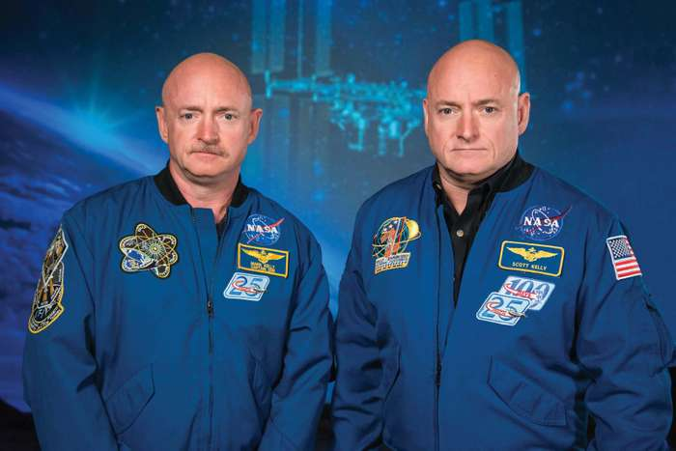
Telomeres in Space and time
Mark (left) and Scott (right) Kelly are identical twin astronauts
Scott spent a year in space, Mark did not
When Scott returned, his telomeres were LONGER
But once back on earth they began to shorten again
How? Why? Environment and external influences on telomere regulation

Slide 18
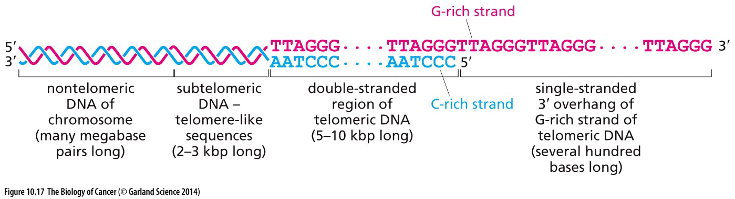
Telomeres are ‘junk DNA’- why does their shortening matter?
Single strand DNA is typically sensed by the cell as DNA damage
The TTAGGG repetitive sequence of the telomere allows for a specialized structure that ‘hides’ the single stranded DNA

Slide 19
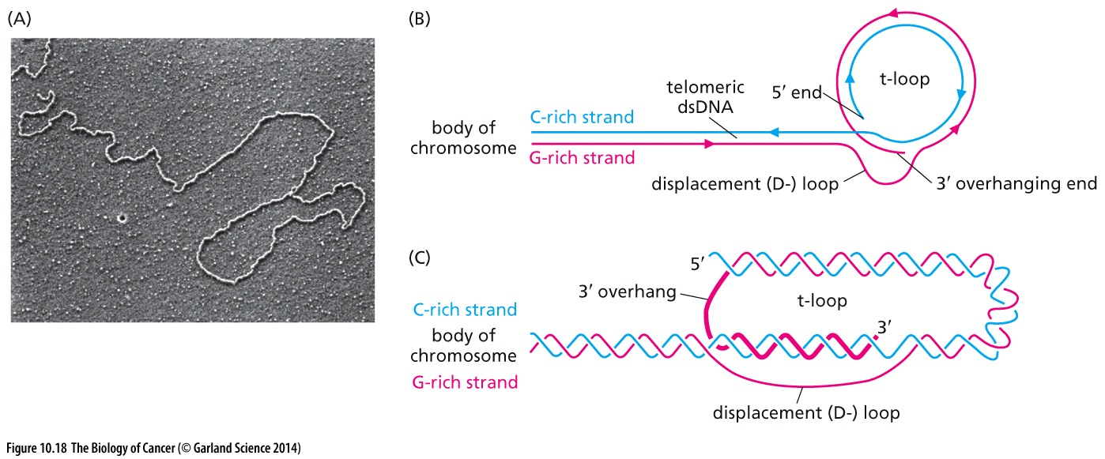
The t-loop structure protects single strand ends from recruiting DNA damage response proteins and activating repair mechanisms
When telomeres get too short, the t-loop can not form

Slide 20
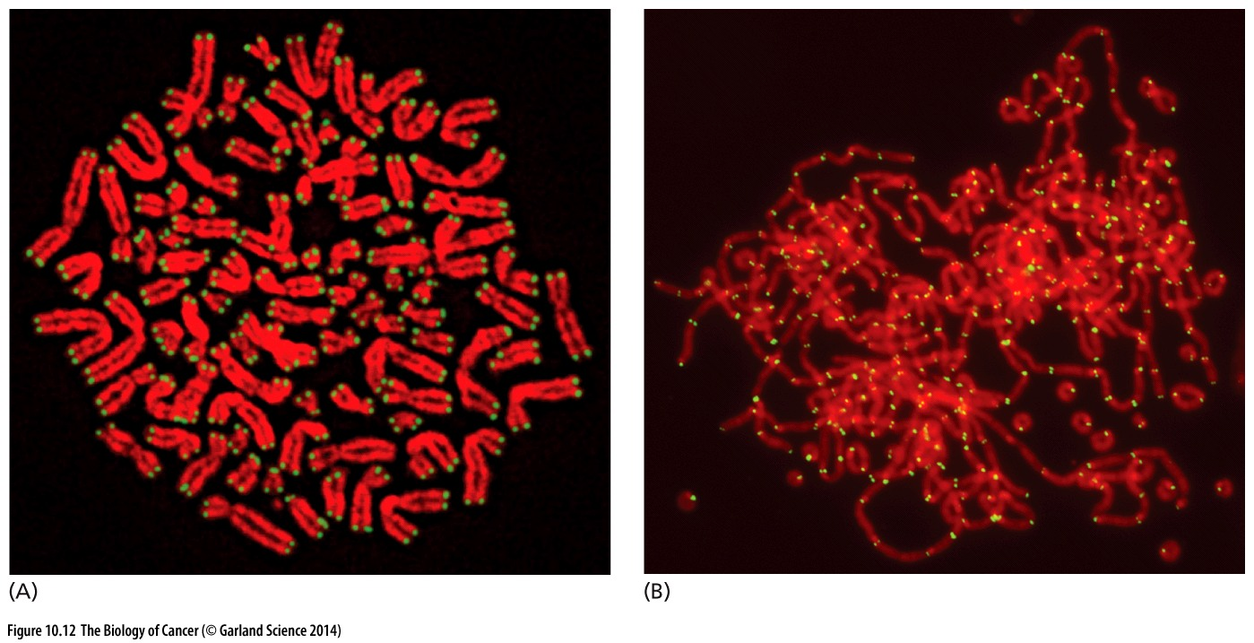
Too-short telomeres active DDR
DNA damage repair mechanisms fuse ‘broken’ chromosome ends together
‘Quick fix’ becomes catastrophic during cell division

Slide 21
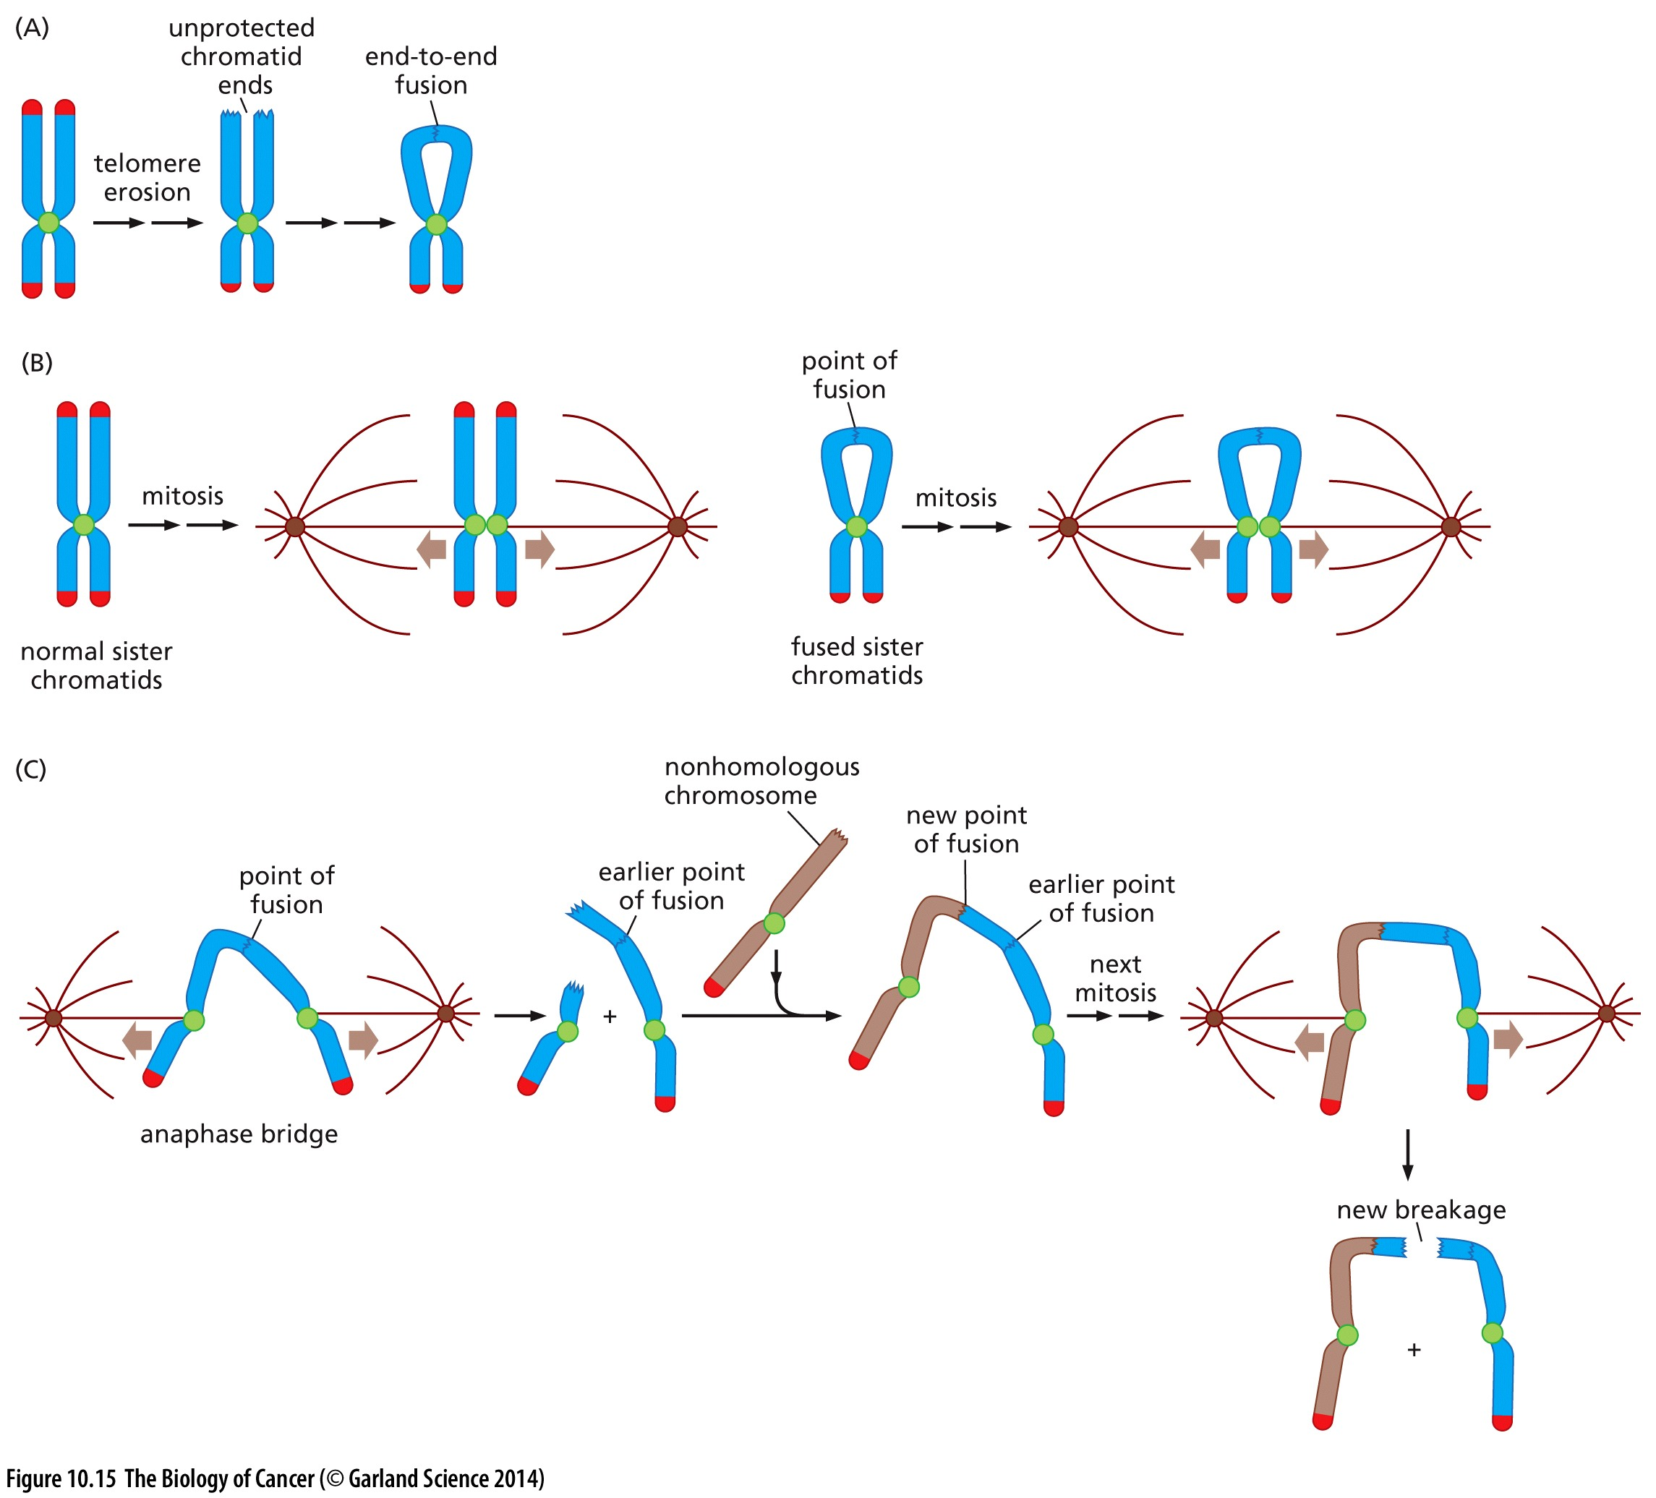
Consequences of fusion
Replicated sister chromosomes often become fused. Why?

Slide 22
Consequences of telomere fusion
Replicated sister chromosomes often become fused.
During mitosis replicated sisters get pulled apart

Slide 23
Consequences of telomere fusion
Replicated sister chromosomes often become fused.
During mitosis replicated sisters get pulled apart
Fused chromosomes break
Cycle of fusion –bridge- break repeats

Slide 24
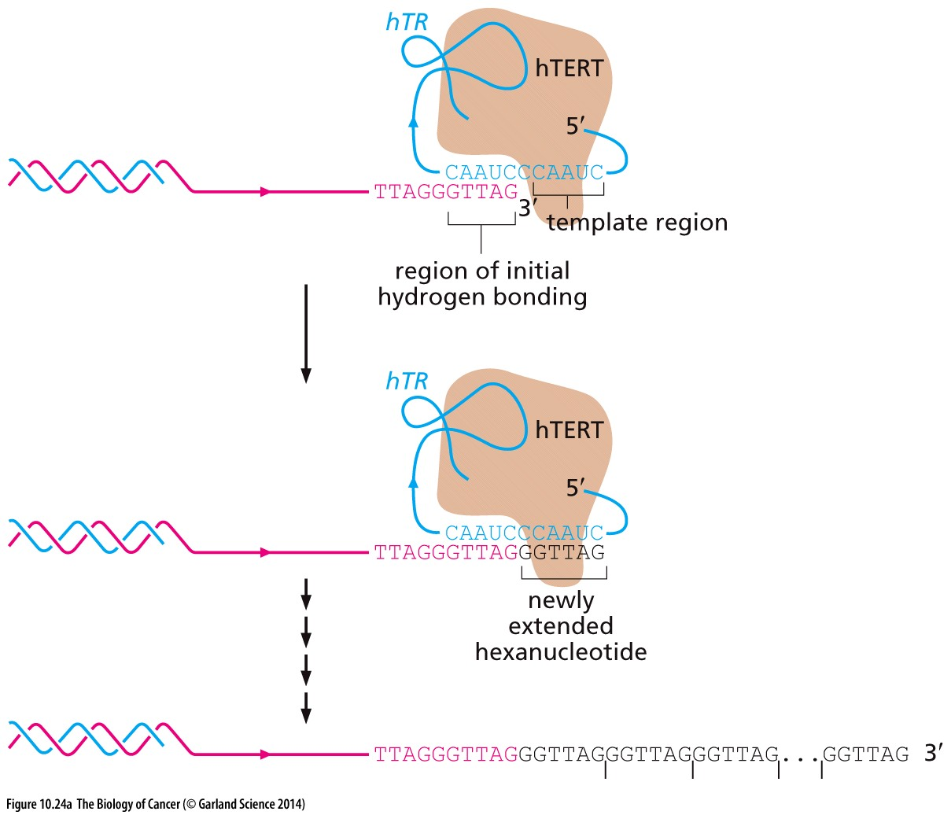
Achieving replicative immortality
Genome encodes for the solution!
Some cells express low levels of the enzyme telomerase
Telomerase functions to provide the template to elongate the 3’ end of DNA
Some oncogenes (Myc) promote telomerase (TERT) expression

Slide 25
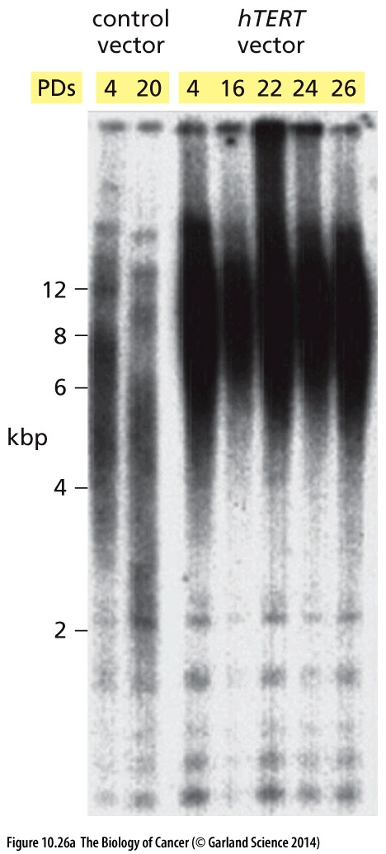
Achieving replicative immortality
Telomere length can be visualized wit southern blot
DNA is cut with an enzyme that does not bind to telomere repeats
DNA is run on a gel, smaller fragments migrate faster through the gel
Telomere DNA is detected with a probe complementary to the TTAGGG sequence
Telomeres normally shorten with population doublings
Increased expression of human telomerase (hTERT) prevents telomere shortening

Slide 26
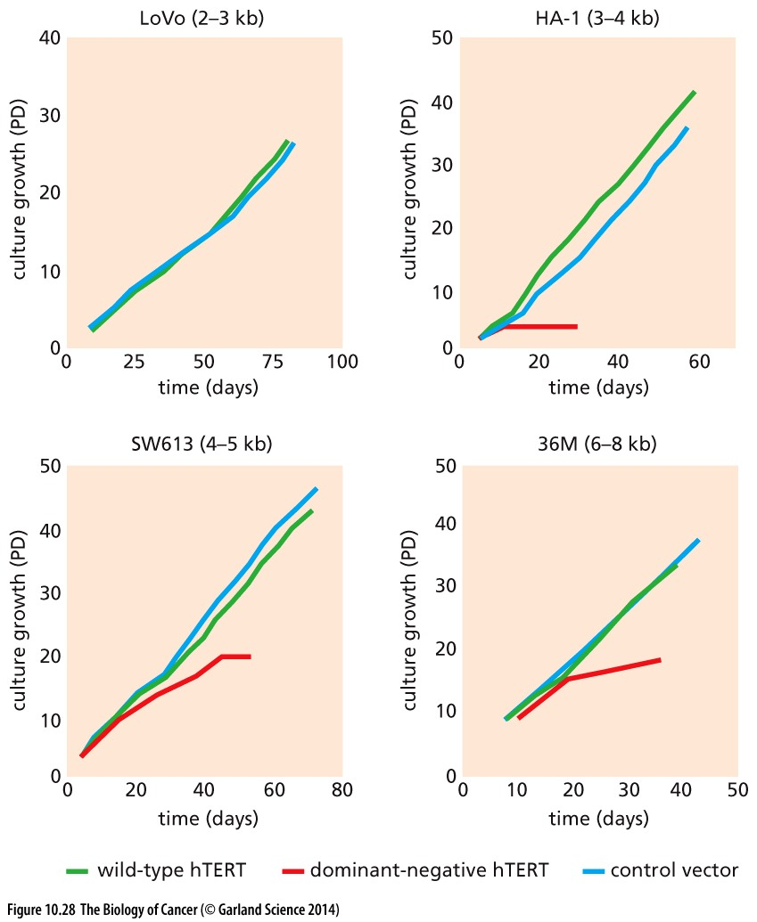
Targeting telomerase
Normal cells barely express telomerase
85% of cancer cells express it highly…
And they need it to remain proliferative!
Dominant negative telomerase results in crisis and cell death in a telomere length-dependent fashion
Die immediately

Slide 27
Targeting telomerase
Normal cells barely express telomerase
85% of cancer cells express it highly…
And they need it to remain proliferative!
Dominant negative telomerase results in crisis and cell death in a telomere length-dependent fashion
Die immediately
What about the other 15% of cancer cells?
How do they achieve replicative immortality?

Slide 28
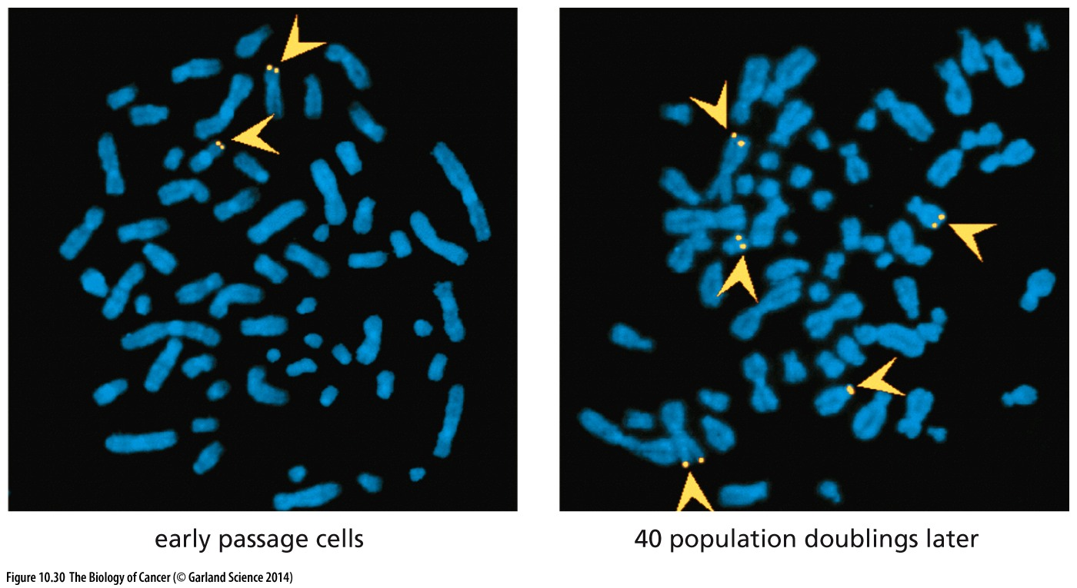
ALT for immortality
~15% of cancer cells use an alternative lengthening of telomeres process to avoid crisis
Often seen in osteosarcomas and soft tissue sarcomas → of mesenchymal lineage where expressed genes repress hTERT gene
Depends on the exchange of sequence between different chromosomes
By why isn’t ALT seen in other cancer contexts?

Slide 29
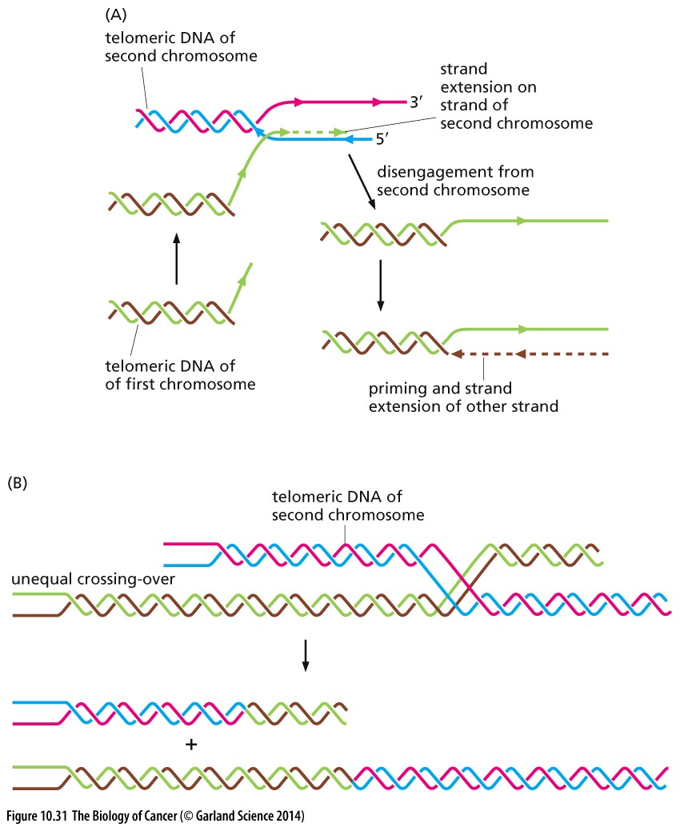
Mechanisims of ALT
How alt is achieved remains unclear
DNA polymerase ‘jumps’ to another chromosomes and uses its telomere as a template
* reminiscent of gene conversion

Slide 30
Mechanisims of ALT
How alt is achieved remains unclear
Cross-over events where two telomeres fuse
One gets longer
The other gets shorter
*reminiscent of recombination events

Slide 31
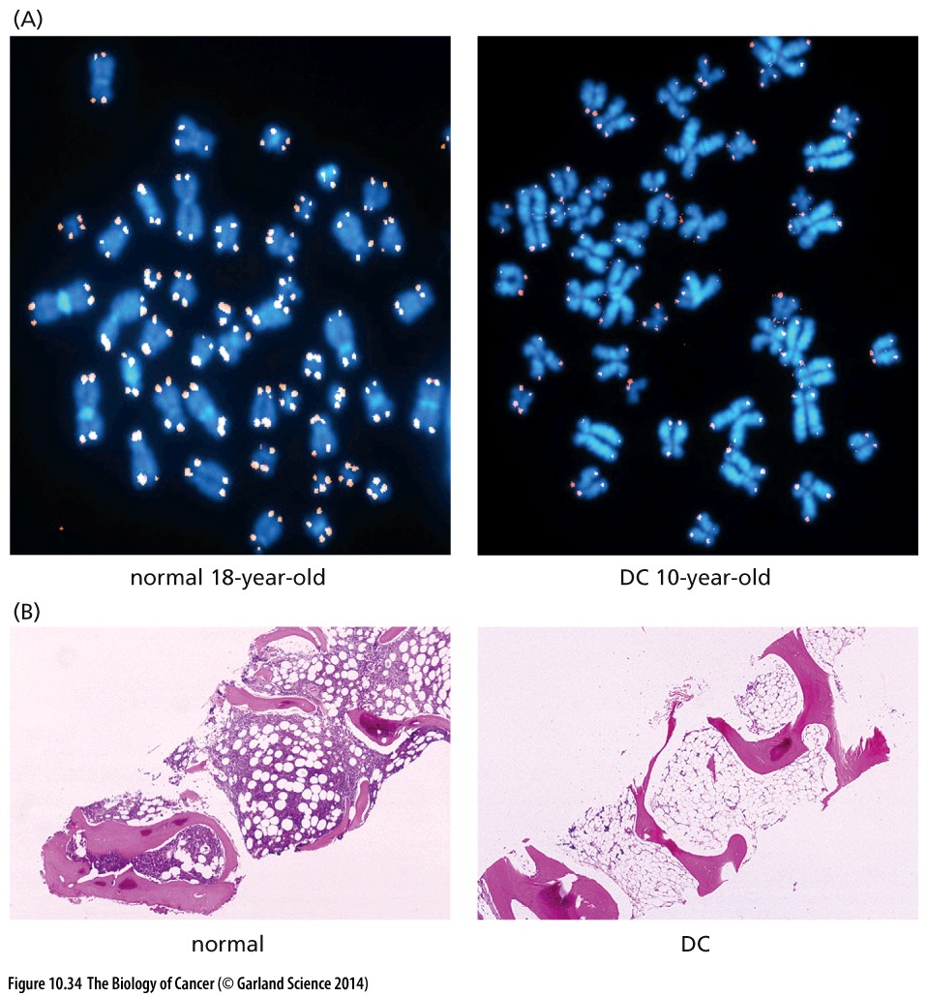
Telomerase defects in disease
Telomerase is needed in highly regenerative tissue (skin, bone marrow)
Mutations in telomerase co-factors result in premature telomere shortening
Cells go into crisis and patients experience a collapse of their hematopoietic system
OR they develop leukemia?!

Slide 32
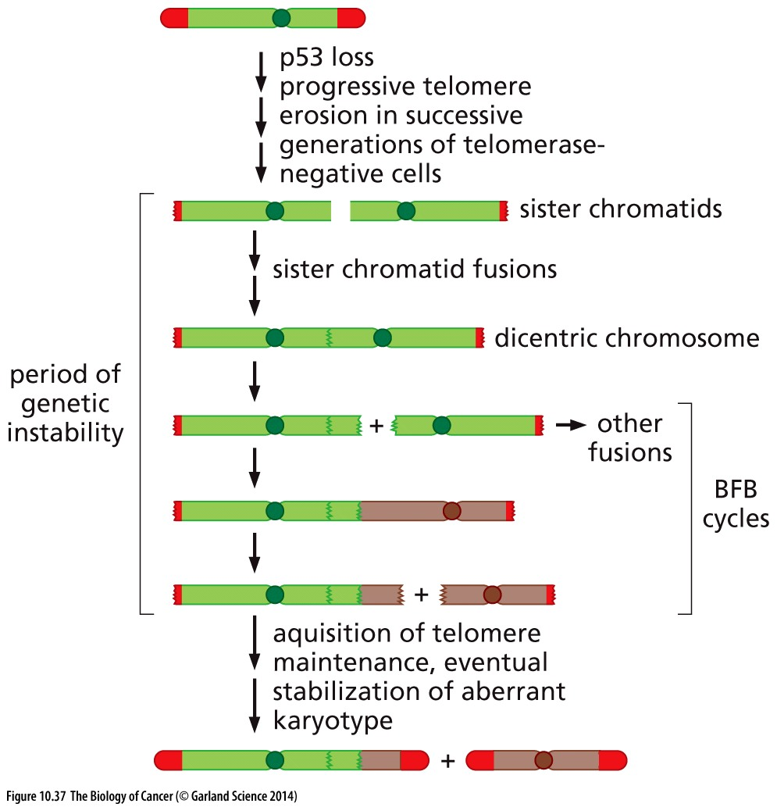
BFB cycles PROMOTE cancer?!
Break-fusion-break cycles create dramatic genetic instability
BFB is mutation-promoting
A cell that survives this initial assault may acquire hTERT activation or ALT mechanisms to stabilize telomeres and promote immortalization

